Slide 1
Application of Bayesian model selection to Lower Namoi aquifer water balance models
Katie Silversides
R. Willem Vervoort

Slide 2
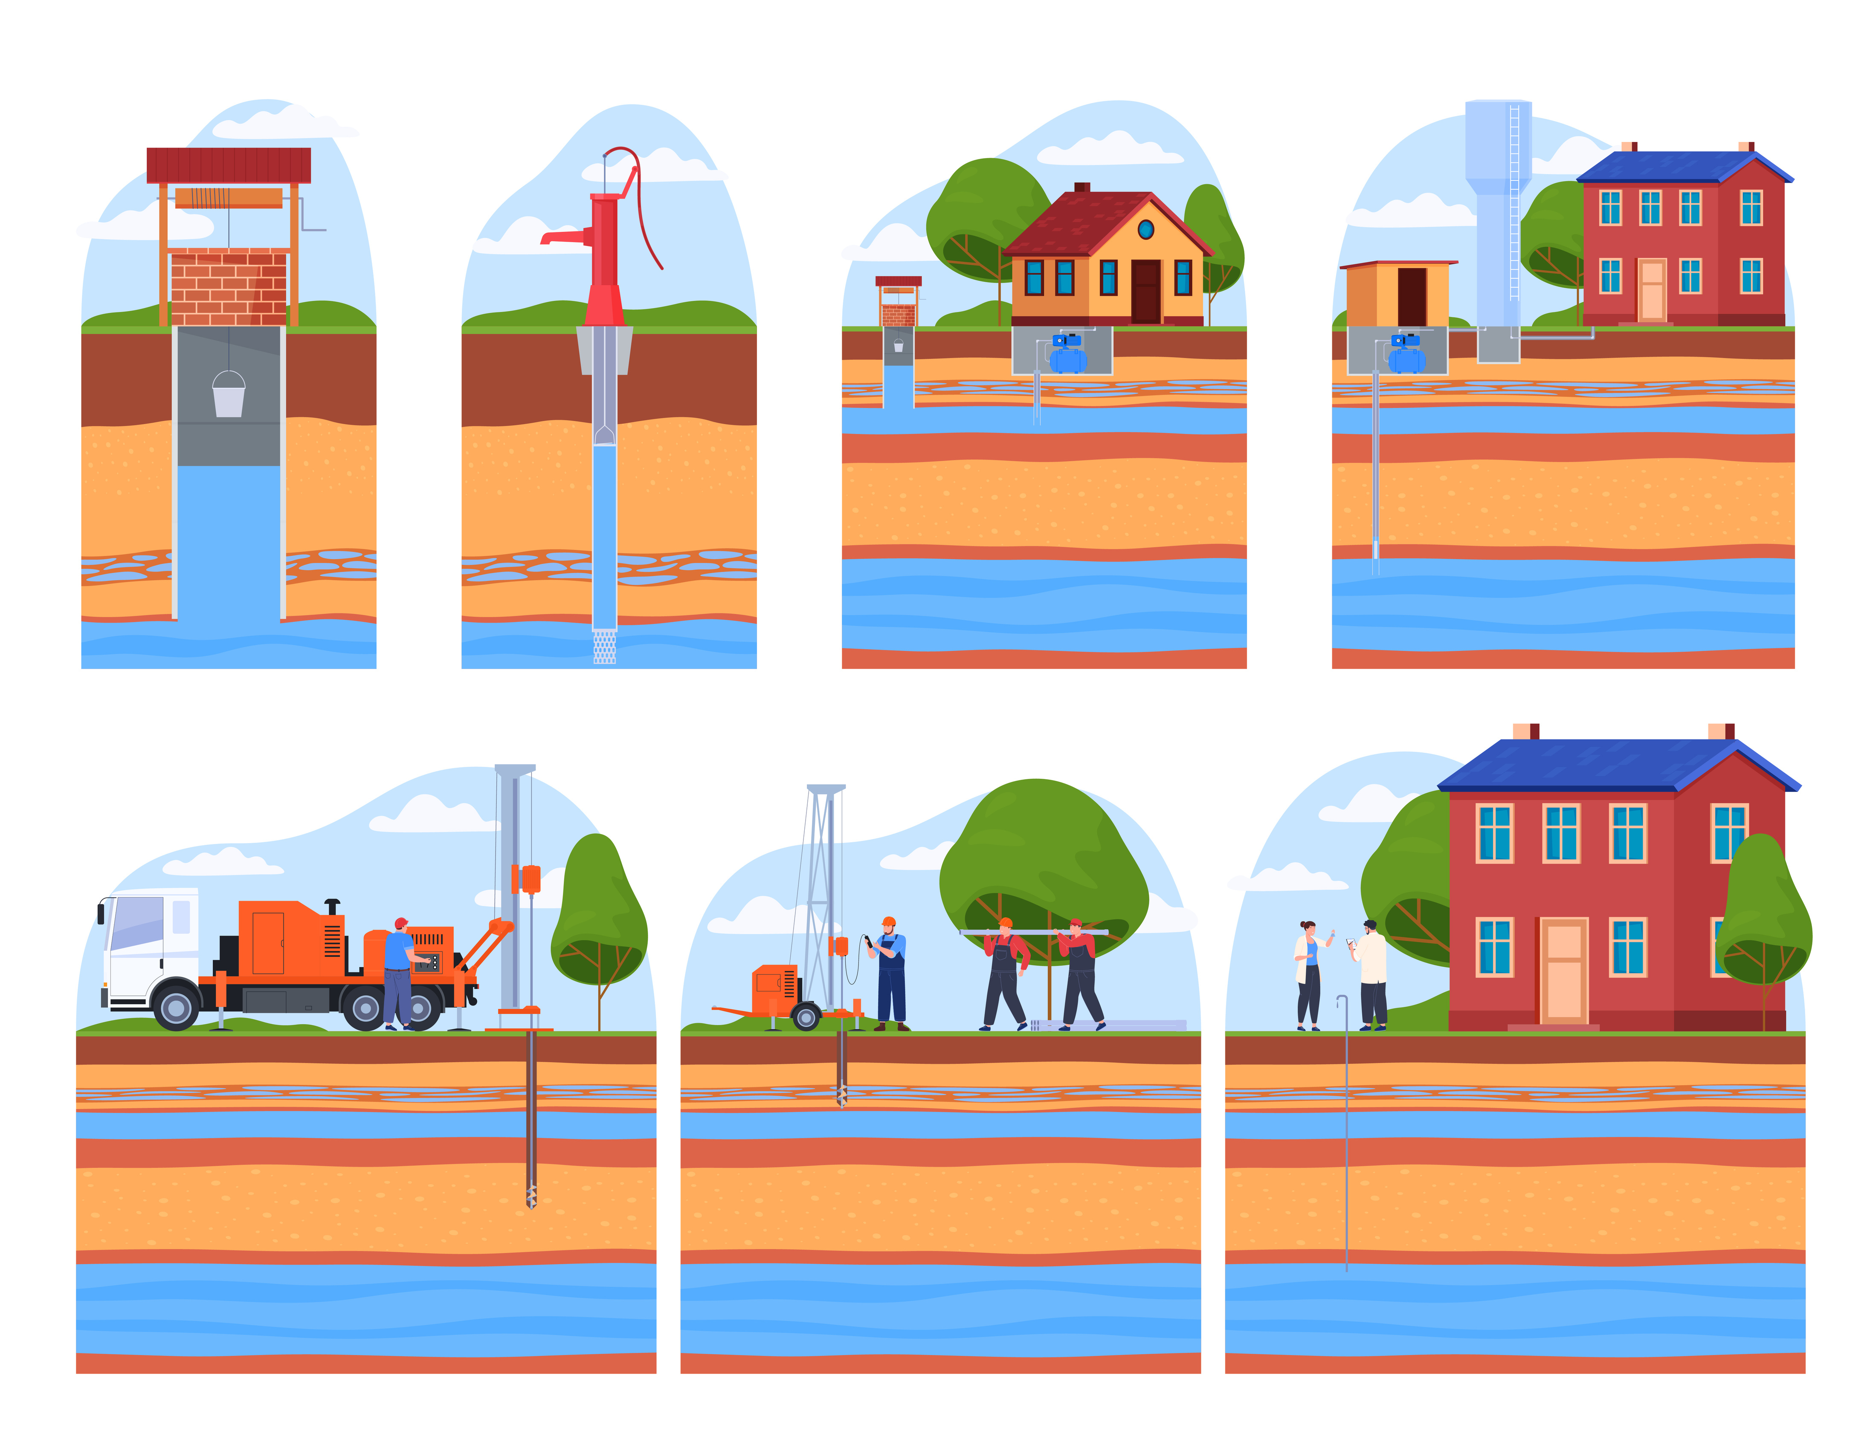
Introduction
Groundwater is vital for reliable water supply.
Underground water cannot be directly observed.
Water balance models can be used to constrain overall inputs and outputs.
Several competing models may equally explain observations.
Some components are well known, others are uncertain.

Slide 3
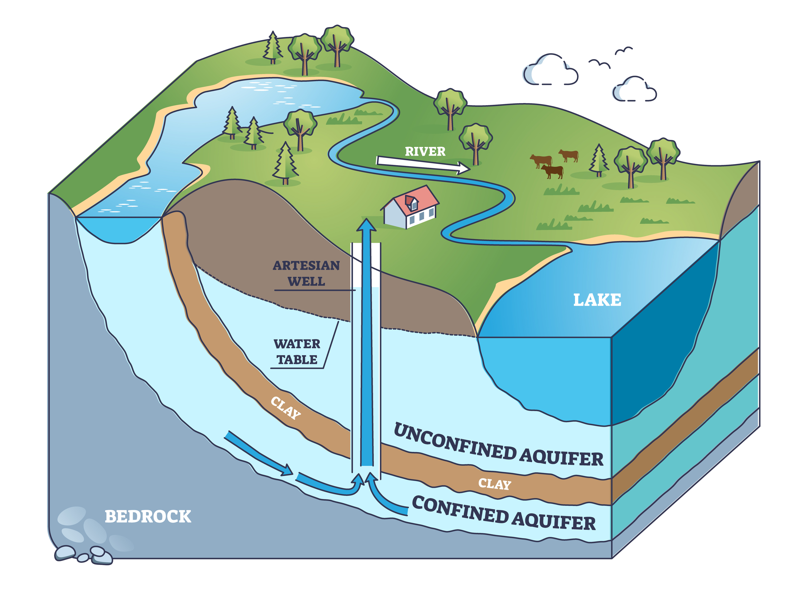
Aims
Evaluate different water balance models.
Probabilistic comparison.
Investigate impacts of component magnitudes
Investigate different reported ranges of pumping values.
Test site is the Lower Namoi.

Slide 4
Bayesian model selection
Applying the method presented by Enemark et al (2019).
Hypotheses relating to uncertain components existing or not.
Initially each has an equal probability.
Prior probability is updated to the posterior probability by evaluating model performance.
Final likelihood of each component based on water balance errors.
Enemark, Peeters, Mallants, Batelaan, Valentine, Sambridge, 2019. Hydrogeological Bayesian Hypothesis Testing through Trans-Dimensional Sampling of a Stochastic Water Balance Model. Water, 11. doi:10.3390/w11071463

Slide 5
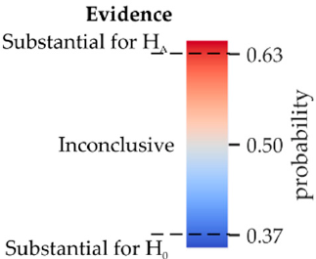
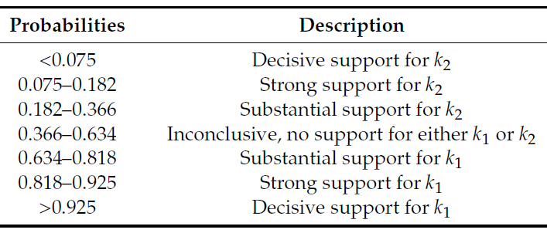
Method
Model includes every possibly combination of the uncertain components.
Multiple runs with random values.
Metropolis-Hastings sampling to find model with the smallest water balance error.
The number of times a specific model structure was identified indicates the posterior likelihood.
From Enemark et al 2019

Slide 6
Certain inputs and outputs
Hydrologists confident.
Most ranges are based on Barrett (2012).
The pumping values varied to include:
minimum and maximum of actual values pumped,
mean ± stdev
mean ± stdev/2
planned pumping values.
Parameter | Min | Max
GAB | 8 | 10
River in | 30 | 35
Rainfall | 40 | 45
Lateral flow in | 0 | 0.5
River out | 1 | 3
Pumping | ? | ?
Lateral flow out | 4.5 | 6.5
Barrett, C., 2012. Upper Namoi Groundwater Source – Status Report 2011. NSW Department of Primary Industries, Office of Water, Sydney

Slide 7
Uncertain inputs and outputs
Decrease in water storage.
Outputs:
Additional Lateral flow out.
Additional pumping.
Evapotranspiration.
Inputs:
Irrigation in.
Additional GAB in.
Parameter | Min | Max
Storage | -20 | 0
Additional lateral flow out | 0 | 1
Additional pumping | 10 | 25
Irrigation in | 2 | 4
Additional GAB in | 2 | 6
Evapotranspiration | 12 | 16

Slide 8
Pumping = min to max (15-110 GL/year)
No support for any hypothesis.
Pumping range multiple times the range of other components.
Essentially representing a large uncertainty.
Simple posterior probability that the component exists
m1 | Storage | 0.52
m2 | Lateral flow out | 0.49
m3 | Additional pumping | 0.49
m4 | Irrigation in | 0.51
m5 | Additional GAB in | 0.55
m6 | Evapotranspiration | 0.50

Slide 9
Pumping = min to max (15-110 GL/year)
Conditional posterior probability
Conditional probabilities show a weak increase in probability for some components:
Additional GAB if there is a decrease in storage or additional pumping.
Evapotranspiration if there is additional pumping.
No additional pumping if no evapotranspiration.
m1 |  | 0.52 | 0.44 | 0.55 | 0.57 | 0.46
m2 | 0.49 |  | 0.52 | 0.48 | 0.48 | 0.47
m3 | 0.41 | 0.51 |  | 0.44 | 0.46 | 0.58
m4 | 0.54 | 0.50 | 0.46 |  | 0.56 | 0.52
m5 | 0.60 | 0.54 | 0.52 | 0.61 |  | 0.57
m6 | 0.45 | 0.48 | 0.60 | 0.51 | 0.52
 | m1 | m2 | m3 | m4 | m5 | m6
Probability of row, given column is true
m1 |  | 0.52 | 0.60 | 0.49 | 0.46 | 0.57
m2 | 0.49 |  | 0.47 | 0.50 | 0.50 | 0.51
m3 | 0.57 | 0.46 |  | 0.53 | 0.51 | 0.39
m4 | 0.48 | 0.52 | 0.55 |  | 0.44 | 0.49
m5 | 0.49 | 0.56 | 0.57 | 0.49 |  | 0.52
m6 | 0.56 | 0.52 | 0.41 | 0.49 | 0.48
 | m1 | m2 | m3 | m4 | m5 | m6
m1 | Storage | 0.52
m2 | Lateral flow out | 0.49
m3 | Additional pumping | 0.49
m4 | Irrigation in | 0.51
m5 | Additional GAB in | 0.55
m6 | Evapotranspiration | 0.50
Simple posterior probability that the component exists
Probability of row, given column is false

Slide 10
Pumping = mean ± 1stdev (39-98 GL/year)
Reduced range of pumping.
Uncertain components have a clearer impact.
Still no substantial support for any component existing.
Substantial support for no additional pumping.
Simple posterior probability that the component exists
m1 | Storage | 0.60
m2 | Lateral flow out | 0.50
m3 | Additional pumping | 0.33
m4 | Irrigation in | 0.54
m5 | Additional GAB in | 0.57
m6 | Evapotranspiration | 0.37

Slide 11
Pumping = mean ± 1stdev (39-98 GL/year)
Conditional posterior probability
Using the conditional probabilities, there is substantial support for:
A decrease in storage if there is additional GAB.
Additional GAB in if there is irrigation in.
No additional pumping.
No evapotranspiration in most cases.
m1 |  | 0.59 | 0.60 | 0.62 | 0.64 | 0.60
m2 | 0.49 |  | 0.50 | 0.49 | 0.49 | 0.47
m3 | 0.33 | 0.33 |  | 0.35 | 0.32 | 0.30
m4 | 0.56 | 0.53 | 0.56 |  | 0.60 | 0.54
m5 | 0.60 | 0.56 | 0.56 | 0.64 |  | 0.62
m6 | 0.36 | 0.35 | 0.33 | 0.37 | 0.40
 | m1 | m2 | m3 | m4 | m5 | m6
Probability of row, given column is true
m1 |  | 0.62 | 0.61 | 0.58 | 0.56 | 0.61
m2 | 0.52 |  | 0.51 | 0.51 | 0.51 | 0.52
m3 | 0.34 | 0.34 |  | 0.32 | 0.35 | 0.35
m4 | 0.52 | 0.55 | 0.53 |  | 0.46 | 0.54
m5 | 0.53 | 0.58 | 0.58 | 0.50 |  | 0.55
m6 | 0.37 | 0.39 | 0.39 | 0.37 | 0.33
 | m1 | m2 | m3 | m4 | m5 | m6
m1 | Storage | 0.60
m2 | Lateral flow out | 0.50
m3 | Additional pumping | 0.33
m4 | Irrigation in | 0.54
m5 | Additional GAB in | 0.57
m6 | Evapotranspiration | 0.37
Simple posterior probability that the component exists
Probability of row, given column is false

Slide 12
Pumping = mean ± 0.5stdev (54-83 GL/year)
Further limiting the range of pumping increased these trends.
Substantial support for a decrease in storage.
Substantial support for no evapotranspiration.
Strong support for no additional pumping.
There is no evidence for or against additional lateral flow out.
Simple posterior probability that the component exists
m1 | Storage | 0.71
m2 | Lateral flow out | 0.50
m3 | Additional pumping | 0.16
m4 | Irrigation in | 0.55
m5 | Additional GAB in | 0.57
m6 | Evapotranspiration | 0.23

Slide 13
Pumping = mean ± 0.5stdev (54-83 GL/year)
Conditional posterior probability
Conditional probability shows:
Additional GAB and irrigation in have substantial support in some cases.
There is no evidence for or against additional lateral flow out.
m1 |  | 0.70 | 0.90 | 0.72 | 0.70 | 0.86
m2 | 0.49 |  | 0.49 | 0.50 | 0.49 | 0.48
m3 | 0.20 | 0.15 |  | 0.16 | 0.17 | 0.06
m4 | 0.56 | 0.55 | 0.57 |  | 0.62 | 0.68
m5 | 0.56 | 0.56 | 0.63 | 0.65 |  | 0.73
m6 | 0.28 | 0.22 | 0.09 | 0.29 | 0.29
 | m1 | m2 | m3 | m4 | m5 | m6
Probability of row, given column is true
m1 |  | 0.73 | 0.68 | 0.70 | 0.73 | 0.67
m2 | 0.53 |  | 0.51 | 0.50 | 0.52 | 0.51
m3 | 0.05 | 0.16 |  | 0.15 | 0.13 | 0.18
m4 | 0.53 | 0.55 | 0.54 |  | 0.45 | 0.51
m5 | 0.59 | 0.58 | 0.56 | 0.47 |  | 0.52
m6 | 0.11 | 0.24 | 0.25 | 0.16 | 0.14
 | m1 | m2 | m3 | m4 | m5 | m6
m1 | Storage | 0.71
m2 | Lateral flow out | 0.50
m3 | Additional pumping | 0.16
m4 | Irrigation in | 0.55
m5 | Additional GAB in | 0.57
m6 | Evapotranspiration | 0.23
Simple posterior probability that the component exists
Probability of row, given column is false

Slide 14
Pumping = planned (75-82 GL/year)
Only substantial support for no additional pumping.
Trends similar to previous cases.
Components more dependent on which other components are included.
Simple posterior probability that the component exists
m1 | Storage | 0.58
m2 | Lateral flow out | 0.52
m3 | Additional pumping | 0.31
m4 | Irrigation in | 0.48
m5 | Additional GAB in | 0.47
m6 | Evapotranspiration | 0.40

Slide 15
Pumping = planned (75-82 GL/year)
Conditional posterior probability
Conditional probability shows strong support for:
A decrease in storage if there is additional pumping.
Irrigation in if there is evapotranspiration.
Additional GAB if there is evapotranspiration.
No additional pumping if there is lateral flow out.
No additional storage if there is lateral flow out, irrigation in or additional GAB.
No additional GAB if there is no irrigation in or evapotranspiration.
No evapotranspiration if there is no decrease in storage, irrigation in or additional GAB.
Substantial support for:
A decrease in storage if there is evapotranspiration.
No additional pumping if there is evapotranspiration.
No evapotranspiration if there is additional pumping.
No additional pumping if there is no decrease in storage.
m1 |  | 0.59 | 0.88 | 0.61 | 0.63 | 0.78
m2 | 0.53 |  | 0.51 | 0.50 | 0.50 | 0.49
m3 | 0.47 | 0.31 |  | 0.38 | 0.38 | 0.12
m4 | 0.51 | 0.47 | 0.59 |  | 0.60 | 0.64
m5 | 0.51 | 0.45 | 0.57 | 0.58 |  | 0.67
m6 | 0.54 | 0.38 | 0.15 | 0.52 | 0.58
 | m1 | m2 | m3 | m4 | m5 | m6
Probability of row, given column is true
m1 |  | 0.56 | 0.44 | 0.55 | 0.53 | 0.45
m2 | 0.50 |  | 0.52 | 0.53 | 0.53 | 0.53
m3 | 0.09 | 0.31 |  | 0.25 | 0.25 | 0.44
m4 | 0.45 | 0.50 | 0.44 |  | 0.38 | 0.38
m5 | 0.41 | 0.48 | 0.42 | 0.36 |  | 0.33
m6 | 0.21 | 0.42 | 0.51 | 0.28 | 0.25
 | m1 | m2 | m3 | m4 | m5 | m6
m1 | Storage | 0.58
m2 | Lateral flow out | 0.52
m3 | Additional pumping | 0.31
m4 | Irrigation in | 0.48
m5 | Additional GAB in | 0.47
m6 | Evapotranspiration | 0.40
Simple posterior probability that the component exists
Probability of row, given column is false

Slide 16
Discussion
A really large range for pumping creates too much uncertainty, resulting in no support.
Restricting the pumping range increased the support.
Increased support for a decrease in storage and against additional pumping or evapotranspiration.
Using the predicted pumping values made the components more conditional on other included components.
It is hard to get support for a component that has a relatively small value.

Slide 17
Conclusions
The values used in model selection need to be carefully considered so that they are realistic, but the scale between the different components is considered.
Future work could include modelling individual years, where values such as the known pumping can be tightly constrained.
Investigate different behaviours during wet and dry years.

